Slide 1
Object Detection
Van Khoa LE

Slide 2
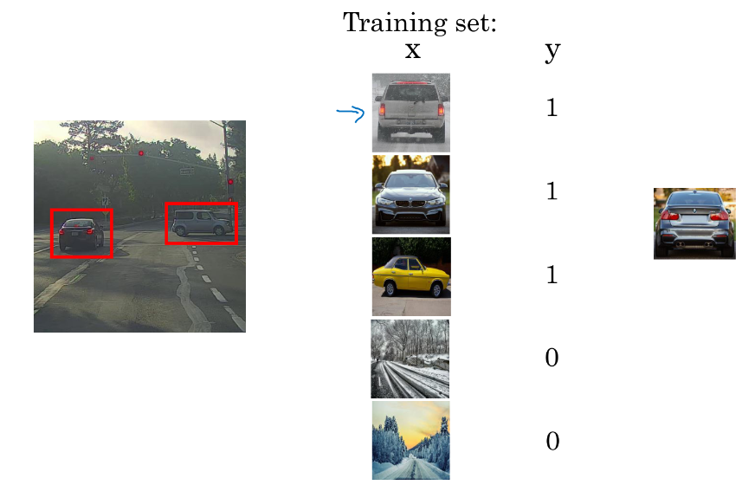
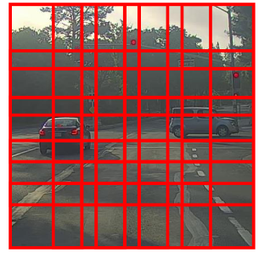
Sliding window
Wasting ressources and imprecise box detection

Slide 3
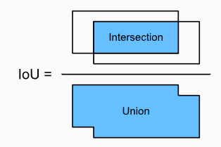
IoU

Slide 4
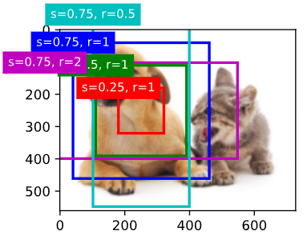
Anchor box generator
Multiple anchors (prior) for each pixel
Using 2 parameters: scale s and aspect ratio r

Slide 5
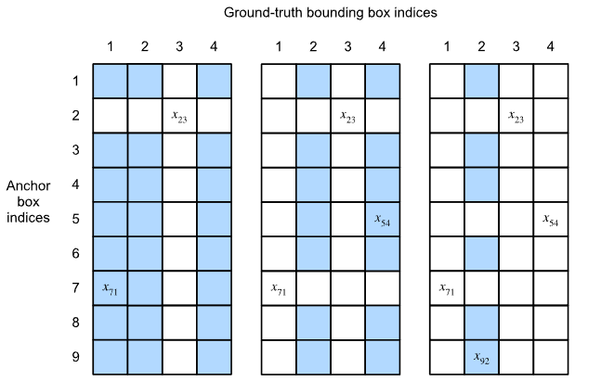
Assign GT boxes to anchor boxes
Assign each bounding box to the anchor box with highest IoU.
Assign the rest of the anchor box to the bbox using an IoU threshold.
1 GT box -> multiple anchor boxes
1 anchor box -> 1 GT box
Assign label and offset for each anchor box
IoU matrix between anchor boxes and GT boxes

Slide 6
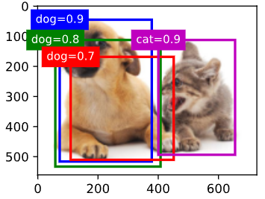
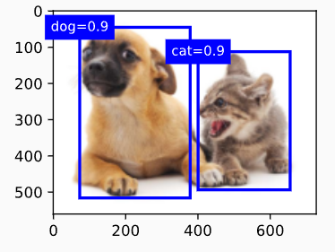
Non max suppression
Sort predicted box in a list L
Get the box B with highest score
Remove other box in the list that has IoU with B>threshold
Continue with the remaining list, and repeat from step 2

Slide 7
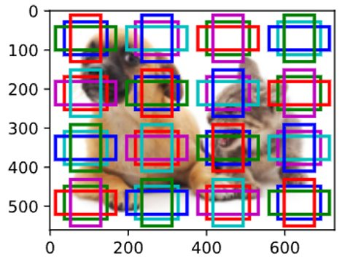
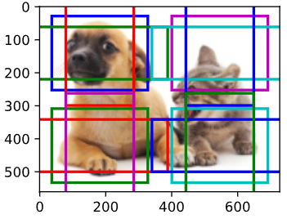
Multiscale object detection
Generate anchor for a RoI instead of each pixel
Using feature maps of several layers
Generate anchors for each feature in the feature map

Slide 8
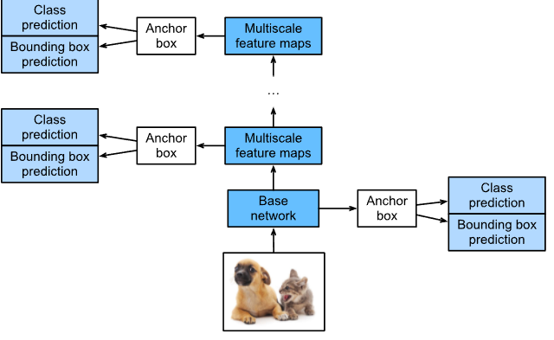
SSD

Slide 9
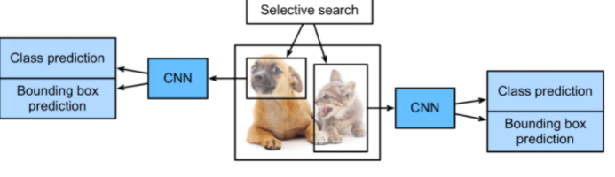
R-CNNs
Perform selective search to extract multiple region proposals on the input image. Each region proposal will be labeled with a class and a ground-truth bounding box.
Choose a pretrained CNN and truncate it before the output layer. Resize each region proposal to the input size required by the network, and output the extracted features for the region proposal through forward propagation.
Take the extracted features and labeled class of each region proposal as an example. Train multiple support vector machines to classify objects, where each support vector machine individually determines whether the example contains a specific class.
Take the extracted features and labeled bounding box of each region proposal as an example. Train a linear regression model to predict the ground-truth bounding box.

Slide 10
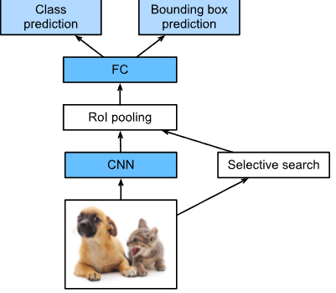
Fast RCNN
Notes:
Compared with the R-CNN, in the fast R-CNN the input of the CNN for feature extraction is the entire image, rather than individual region proposals. Moreover, this CNN is trainable. Given an input image, let the shape of the CNN output be 1×c×h1×w1.
Suppose that selective search generates n region proposals. These region proposals (of different shapes) mark regions of interest (of different shapes) on the CNN output. Then these regions of interest further extract features of the same shape (say height h2 and width w2 are specified) in order to be easily concatenated. To achieve this, the fast R-CNN introduces the region of interest (RoI) pooling layer: the CNN output and region proposals are input into this layer, outputting concatenated features of shape n×c×h2×w2 that are further extracted for all the region proposals.
Using a fully-connected layer, transform the concatenated features into an output of shape n×d, where d depends on the model design.
Predict the class and bounding box for each of the n region proposals. More concretely, in class and bounding box prediction, transform the fully-connected layer output into an output of shape n×q (q is the number of classes) and an output of shape n×4, respectively. The class prediction uses softmax regression.

Slide 11
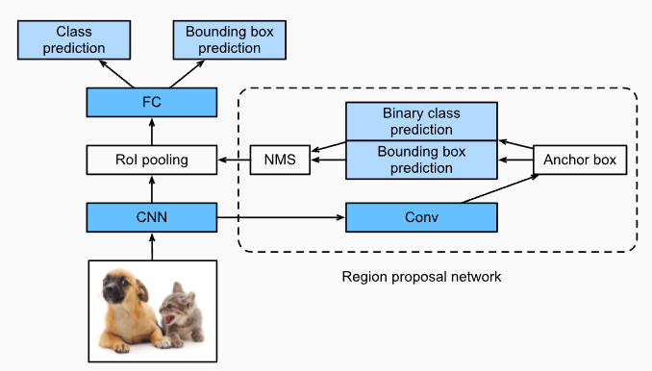
Faster RCNN
Notes:
Use a 3×3 convolutional layer with padding of 1 to transform the CNN output to a new output with c channels. In this way, each unit along the spatial dimensions of the CNN-extracted feature maps gets a new feature vector of length c.
Centered on each pixel of the feature maps, generate multiple anchor boxes of different scales and aspect ratios and label them.
Using the length-c feature vector at the center of each anchor box, predict the binary class (background or objects) and bounding box for this anchor box.
Consider those predicted bounding boxes whose predicted classes are objects. Remove overlapped results using non-maximum suppression. The remaining predicted bounding boxes for objects are the region proposals required by the region of interest pooling layer.

Slide 12
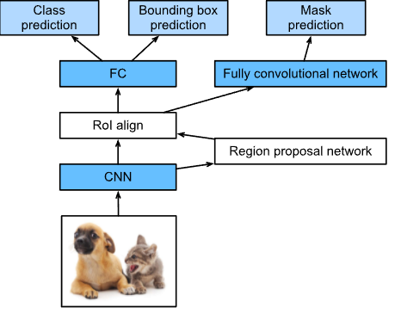
Mask RCNN
Notes:
As shown in Fig. 13.8.5, the mask R-CNN is modified based on the faster R-CNN. Specifically, the mask R-CNN replaces the region of interest pooling layer with the region of interest (RoI) alignment layer. This region of interest alignment layer uses bilinear interpolation to preserve the spatial information on the feature maps, which is more suitable for pixel-level prediction. The output of this layer contains feature maps of the same shape for all the regions of interest. They are used to predict not only the class and bounding box for each region of interest, but also the pixel-level position of the object through an additional fully convolutional network. More details on using a fully convolutional network to predict pixel-level semantics of an image will be provided in subsequent sections of this chapter.

Slide 13
YOLO

Slide 14
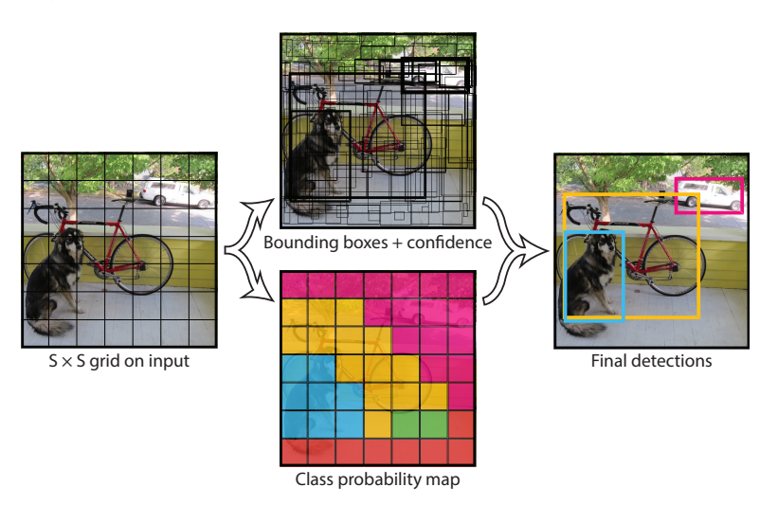
Model

Slide 15
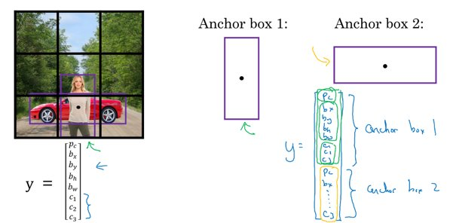
Anchor box

Slide 16
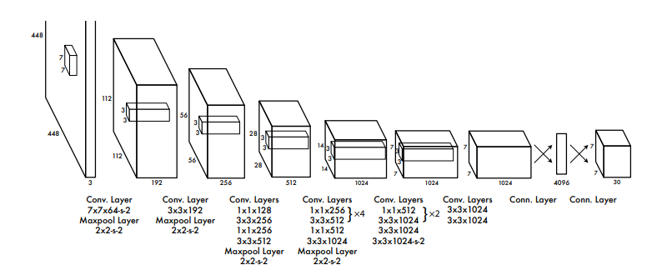
Model

Slide 17
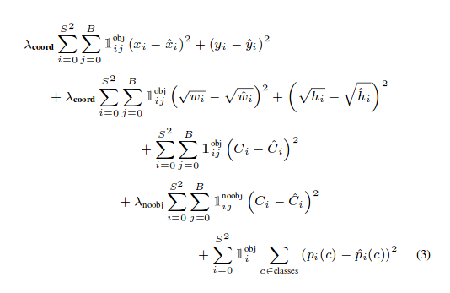
Loss function

Slide 18
YOLOv3

Slide 19
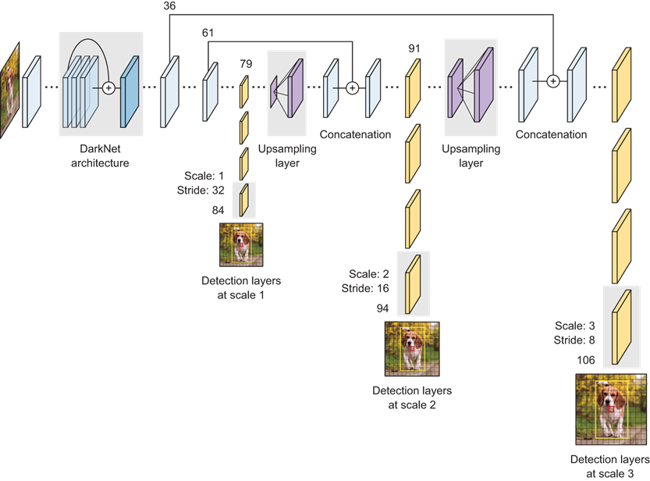
Darknet-53, multiscale prediction
Model: image (416x416) -> CNN -> Feature map (13x13) -> output (N*N*B*(5+C))
B: bounding box
C: number of classes

Slide 20
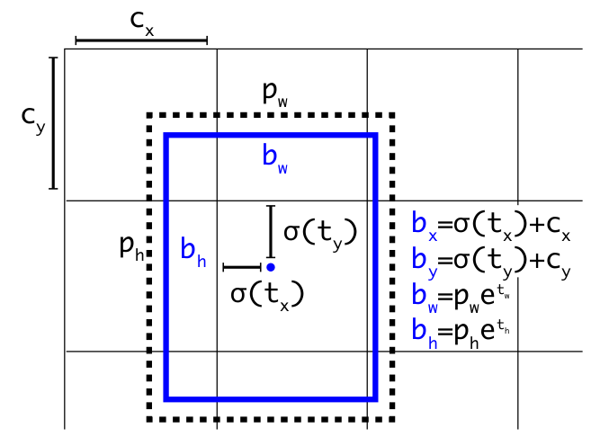
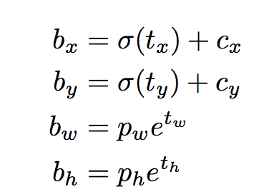
Anchor boxes

Slide 21
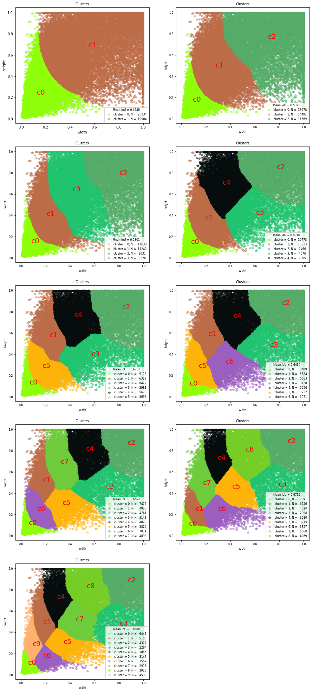
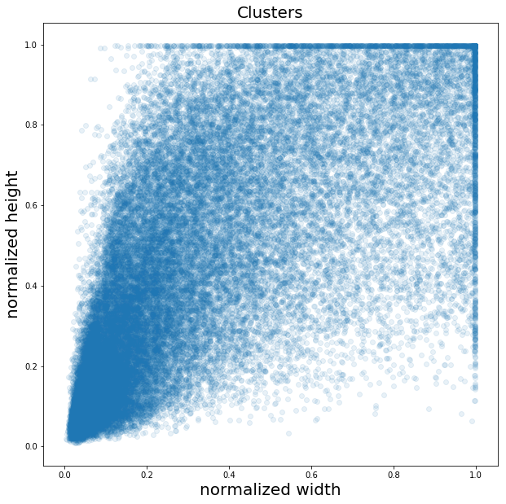
Generate anchors with k-means

Slide 22
Practice
Yolo on VOC
MaskRCNN on pedestrian detection and segmentation

Slide 23
Play with some toolbox
Mmdetection
detectron2

